Slide 1
Matplotlib – Plotting with Python
Dr. Sergio Martinez

Slide 2
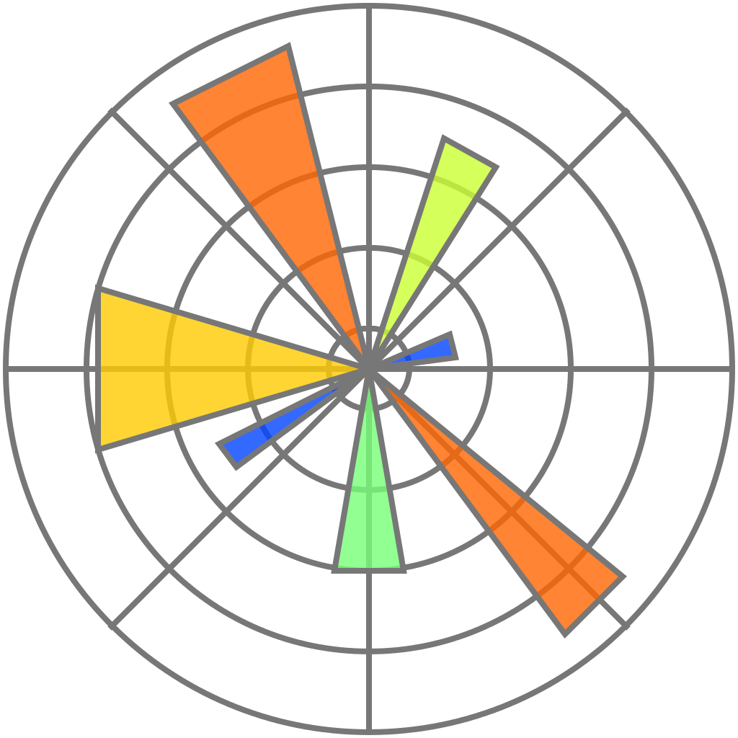
Research Computing Department
2
Course layout
Introduction
Figures and axes
Formatting
2D plots
3D plots
Save plots

Slide 3
Research Computing Department
3
Introduction
Matplotlib is one of the most popular Python packages used for data visualization. Together with NumPy (numerical Python), it can be used as a replacement for Matlab.
It provides an object-oriented API that helps in embedding plots in applications using Python GUI toolkits such as PyQt, WxPythonotTkinter.
It can be used in Python and IPython shells, Jupyter notebook and web application servers.
Matplotlib is written in Python and makes use of NumPy.
At the moment of creating this training course, Matplotlib Version 3.2.2 was used. https://matplotlib.org/3.2.2/contents.html
Matplotlib
Import the package
pyplot API
Plot backend

Slide 4
Research Computing Department
4
Introduction
To begin with Matplotlib, the Pyplot module from Matplotlib package is imported, with an alias plt as a matter of convention.
matplotlib.pyplot is a collection of command style functions that make Matplotlib work like Matlab. Each Pyplot function makes some change to a figure.
Matplotlib
Import the package
pyplot API
Plot backend
import matplotlib.pyplot as plt

Slide 5
Research Computing Department
5
Introduction
pyplot is a module of Matplotlib.
It is collection of command style functions that make Matplotlib work like Matlab. Each Pyplot function makes some change to a figure:
Creates a figure.
Creates a plotting area in a figure.
Plots some lines in a plotting area.
Decorates the plot with labels.
pyplot is stateful, in that it keeps track of the current figure and plotting area, and the plotting functions are directed to the current axes
Let’s see some examples:
01_Introduction/pyplot_stateful.ipynb
Matplotlib
Import the package
pyplot API
Plot backend

Slide 6
Research Computing Department
6
Introduction
It is possible to change the behavior of the notebook when the plots are created. This is achieved by selecting the plot backend.
To set this up, before any plotting or import of matplotlib is performed you must execute the %matplotlib magic command:
%matplotlib inline: will draw static images in the notebook.
%matplotlib notebook: will lead to interactive plots embedded within the notebook, you can zoom and resize the figure.
Let’s see some examples:
01_Introduction/plot_backend.ipynb
Matplotlib
Import the package
pyplot API
Plot backend

Slide 7
Research Computing Department
7
Figures and axes
At its core Matplotlib is object-oriented.
Most of the functions available in matplotlib.pyplot are also available in the matplotlib.axes.Axes class.
Working directly with the objects gives more control and customization to the plots.
In object-oriented interface, Pyplot is used only for a few functions such as figure creation, and the user explicitly creates and keeps track of the figure and axes objects.
Let’s see some examples:
02_Figures_and_axes/pyplot_object_oriented.ipynb
Object-oriented API
Figure class
Axes class

Slide 8
Research Computing Department
8
Figures and axes
The matplotlib.figure module contains the Figure class. It is a top-level container for all plot elements. The Figure object is instantiated by calling the figure() function from the pyplot module.
Let’s see some examples:
02_Figures_and_axes/figures.ipynb
Object-oriented API
Figure class
Axes class
fig = plt.figure()
Sr.No. | Parameter & Description
1 | num : integer or string, optional, default: None If not provided, a new figure will be created. If num is provided, and a figure with this id already exists, make it active, and returns a reference to it. If this figure does not exists, create it and returns it.
2 | figsize : (float, float), optional, default: None Width, height in inches.
3 | dpi : integer, optional, default: None Resolution of the figure.
4 | facecolor : color spec The background color
5 | edgecolor : color spec The border color.
6 | linewidth : float The linewidth of the frame (i.e. the edge linewidth of the figure patch).

Slide 9
Research Computing Department
9
Introduction
Axes object is the region of the image with the data space.
A given figure can contain many Axes, but a given Axes object can only be in one Figure.
The Axes contains two (or three in the case of 3D) Axis objects.
It contain most of the figure elements: Axis, Tick, Label, Legend, Text…
The Axes class and its member functions are the primary entry point to working with the OO interface.
There are multiple constructors to create axes objects. The most logical way is to add axes to a figure using Figure functions.
Object-oriented API
Figure class
Axes class

Slide 10
Research Computing Department
10
Figures and axes
Axes creation I, figure.add_axes():
The calling signature of add_axes is add_axes(rect), where rect is a list [x0, y0, width, height] denoting the lower left point of the new axes in figure coordinates (x0,y0) and its width and height. So the axes is positioned in absolute coordinates on the canvas. E.g.
The values of the parameters are based on the normalized size of the figure.
Object-oriented API
Figure class
Axes class
fig = plt.figure()
ax = fig.add_axes([0,0,1,1])

Slide 11
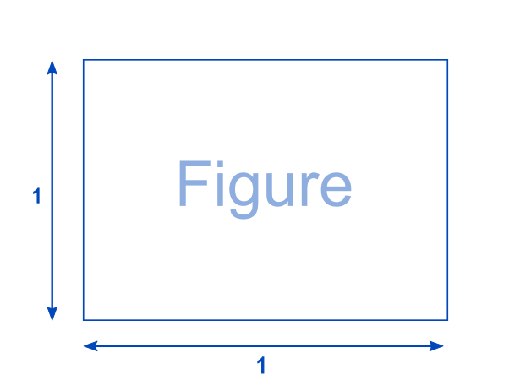
Research Computing Department
11
Figures and axes
Axes creation I, figure.add_axes():
Object-oriented API
Figure class
Axes class

Slide 12
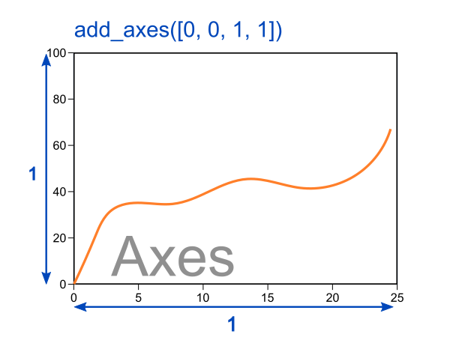
Research Computing Department
12
Figures and axes
Axes creation I, figure.add_axes():
Object-oriented API
Figure class
Axes class

Slide 13
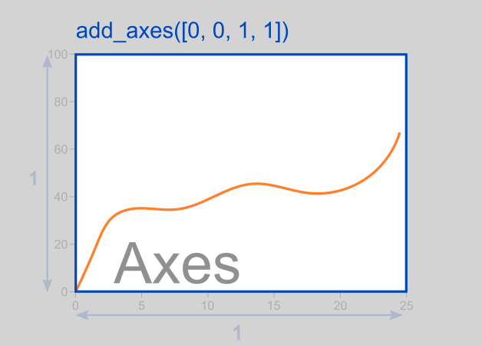
Research Computing Department
13
Figures and axes
Axes creation I, figure.add_axes():
Object-oriented API
Figure class
Axes class

Slide 14
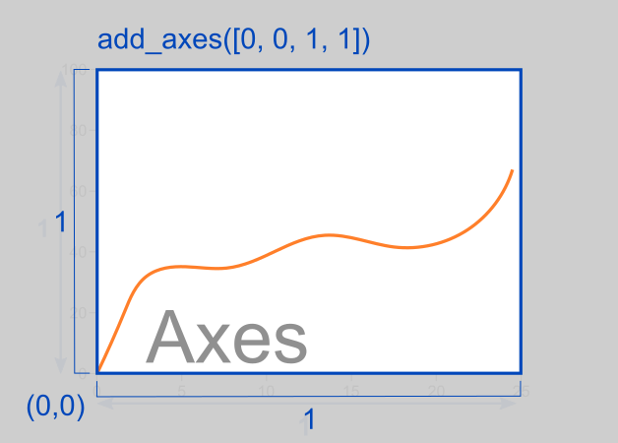
Research Computing Department
14
Figures and axes
Axes creation I, figure.add_axes():
Object-oriented API
Figure class
Axes class

Slide 15
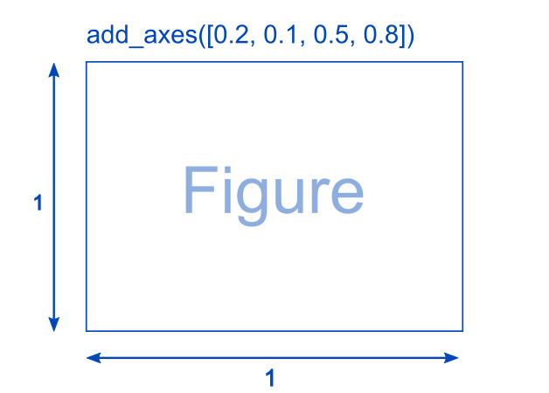
Research Computing Department
15
Figures and axes
Axes creation I, figure.add_axes():
Object-oriented API
Figure class
Axes class

Slide 16
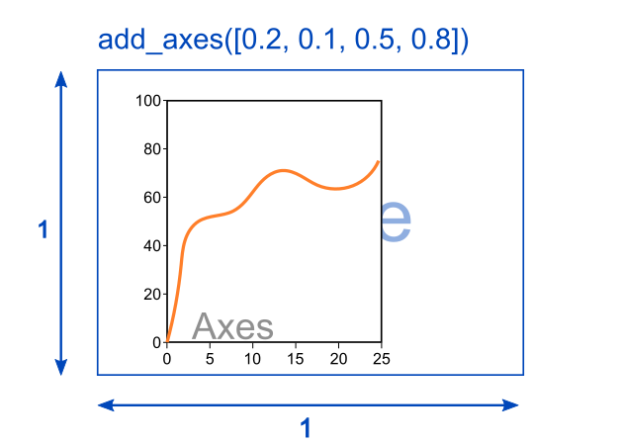
Research Computing Department
16
Figures and axes
Axes creation I, figure.add_axes():
Object-oriented API
Figure class
Axes class

Slide 17
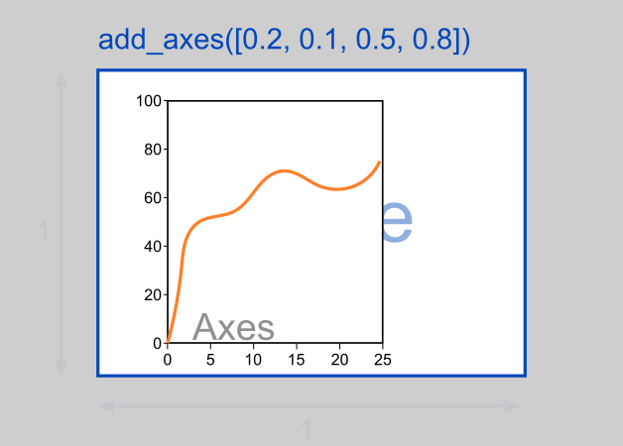
Research Computing Department
17
Figures and axes
Axes creation I, figure.add_axes():
Object-oriented API
Figure class
Axes class

Slide 18
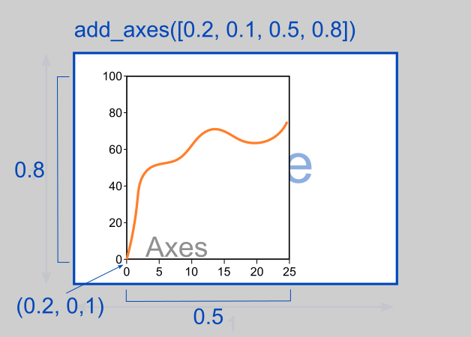
Research Computing Department
18
Figures and axes
Axes creation I, figure.add_axes():
Object-oriented API
Figure class
Axes class

Slide 19
Research Computing Department
19
Figures and axes
Axes creation II, figure.add_subplot():
The calling signature of add_subplot is add_subplot(nrows, ncols, index), it allows to specify where the axes should be situated according to a subplot grid.
The subplot will take the index position on a grid with nrows rows and ncols columns. index starts at 1 in the upper left corner and increases to the right.
Object-oriented API
Figure class
Axes class
fig = plt.figure()
ax = fig.add_subplot(2,3,1)

Slide 20
Research Computing Department
20
Figures and axes
Axes creation II, figure.add_subplot():
Another calling of add_subplot is add_subplot(nrows,ncols, (first,last)), it allows to specify where the axes should be situated according to a subplot grid.
It spans the subplot from first cell to last cell on a grid with nrows rows and ncols columns. index starts at 1 in the upper left corner and increases to the right.
Object-oriented API
Figure class
Axes class
fig = plt.figure()
ax = fig.add_subplot(2,3,(2,5))

Slide 21
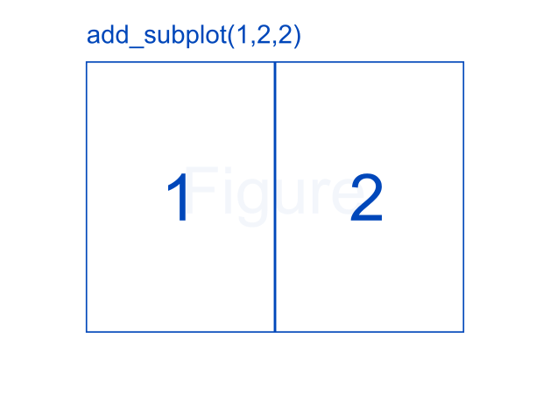
Research Computing Department
21
Figures and axes
Axes creation II, figure.add_subplot():
Object-oriented API
Figure class
Axes class

Slide 22
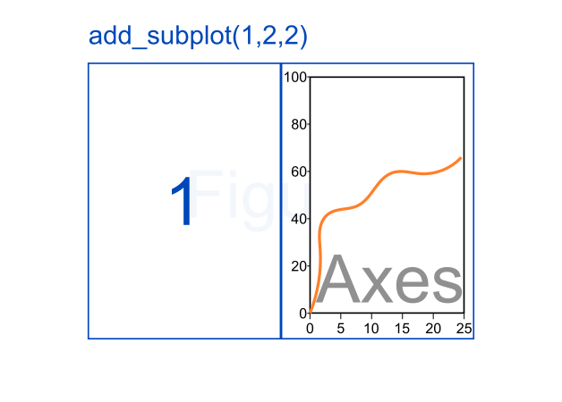
Research Computing Department
22
Figures and axes
Axes creation II, figure.add_subplot():
Object-oriented API
Figure class
Axes class

Slide 23
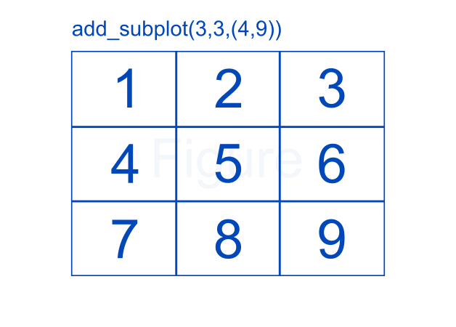
Research Computing Department
23
Figures and axes
Axes creation II, figure.add_subplot():
Object-oriented API
Figure class
Axes class

Slide 24
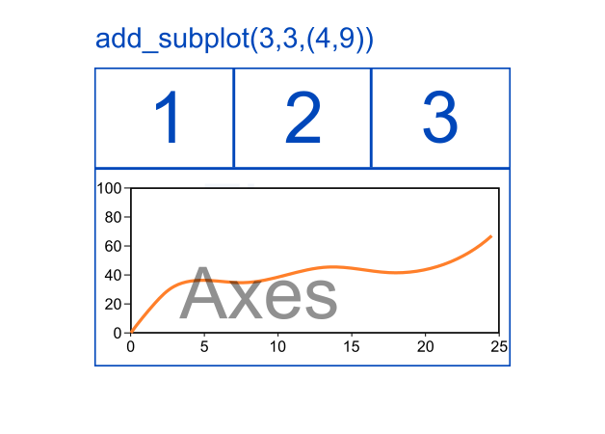
Research Computing Department
24
Figures and axes
Axes creation II, figure.add_subplot():
Object-oriented API
Figure class
Axes class

Slide 25
Research Computing Department
25
Figures and axes
Axes creation III, other functions to create axes
plt.subplot(nrows, ncols, index): In the current figure, the function creates and returns an Axes object, at position index of a grid of nrows by ncols axes. Creating a subplot will delete any pre-existing subplot that overlaps with it beyond sharing a boundary.
plt.subplots(nrows, ncols): The two integer arguments to this function specify the number of rows and columns of the subplot grid. The function returns a figure object and a tuple containing axes objects equal to nrows*ncols. Each axes object is accessible by its index.
Object-oriented API
Figure class
Axes class

Slide 26
Research Computing Department
26
Figures and axes
Axes creation III, other functions to create axes
plt. subplot2grid(shape,location,rowspan,colspan): This function gives more flexibility in creating an axes object at a specific location of the grid. It also allows the axes object to be spanned across multiple rows or columns.
Let’s see some examples:
02_Figures_and_axes/axes.ipynb
Object-oriented API
Figure class
Axes class

Slide 27
Research Computing Department
27
Formatting
The grid() function of axes object sets visibility of grid inside the figure to on or off. You can also display major / minor (or both) ticks of the grid. Additionally color, linestyle and linewidth properties can be set in the grid() function.
Grids
Labels
Spines
Scale
Limits
Ticks
Twin axes
Legend
Sr.No. | Parameter & Description
1 | which{'major', 'minor', 'both'}, optional The grid lines to apply the changes on.
2 | axis{'both', 'x', 'y'}, optional The axis to apply the changes on.
3 | color color
4 | linestyle {'-', '--', '-.', ':', '', (offset, on-off-seq), ...}
5 | linewidth float

Slide 28
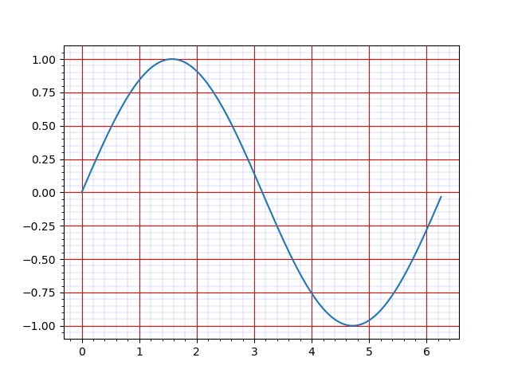
Research Computing Department
28
Formatting
The grid() function of axes object sets visibility of grid inside the figure to on or off. You can also display major / minor (or both) ticks of the grid. Additionally color, linestyle and linewidth properties can be set in the grid() function.
Let’s see some examples:
03_Formatting/grids.ipynb
Grids
Labels
Spines
Scale
Limits
Ticks
Twin axes
Legend

Slide 29
Research Computing Department
29
Formatting
It is always desirable to include labels on the plot:
Axes.set_title(): sets a title for the axes.
Axes.set_xlabel(): sets label of x axis.
Axes.set_ylabel(): sets label of y axis.
Grids
Labels
Spines
Scale
Limits
Ticks
Twin axes
Legend

Slide 30
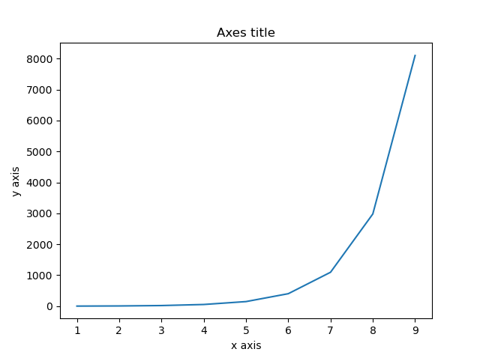
Research Computing Department
30
Formatting
Axes labeling:
Let’s see some examples:
03_Formatting/labels.ipynb
Grids
Labels
Spines
Scale
Limits
Ticks
Twin axes
Legend

Slide 31
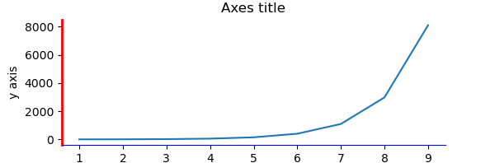
Research Computing Department
31
Formatting
Axis spines are the lines connecting axis tick marks demarcating boundaries of plot area. The axes object has spines located at top, bottom, left and right.
Each spine can be formatted by specifying color and width. Any edge can be made invisible if its color is set to none.
Let’s see some examples:
03_Formatting/spines.ipynb
Grids
Labels
Spines
Scale
Limits
Ticks
Twin axes
Legend

Slide 32
Research Computing Department
32
Formatting
Sometimes, one or a few points are much larger than the bulk of data. In such a case, the scale of an axis needs to be set as logarithmic rather than the normal scale. In Matplotlib, it is possible by setting xscale or yscale property of axes object to ‘log’.
Axes.set_xscale("log"): sets logarithmic scale in x-axis.
Axes.set_yscale("log"): sets logarithmic scale in y-axis.
Grids
Labels
Spines
Scale
Limits
Ticks
Twin axes
Legend

Slide 33
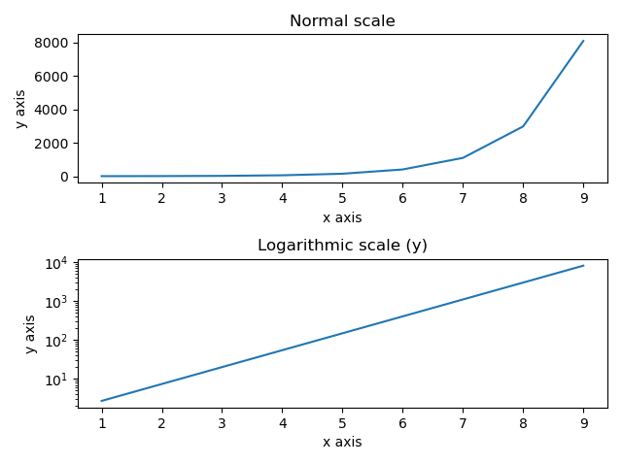
Research Computing Department
33
Formatting
Axes scale:
Let’s see some examples:
03_Formatting/scale.ipynb
Grids
Labels
Spines
Scale
Limits
Ticks
Twin axes
Legend

Slide 34
Research Computing Department
34
Formatting
Matplotlib automatically arrives at the minimum and maximum values of variables to be displayed along x, y (and z axis in case of 3D plot) axes of a plot. However, it is possible to set the limits explicitly by using set_xlim() and set_ylim() functions.
Axes.set_xlim(left, right): Set the x-axis view limits.
Axes.set_ylim(bottom,top): Set the y-axis view limits.
Grids
Labels
Spines
Scale
Limits
Ticks
Twin axes
Legend

Slide 35
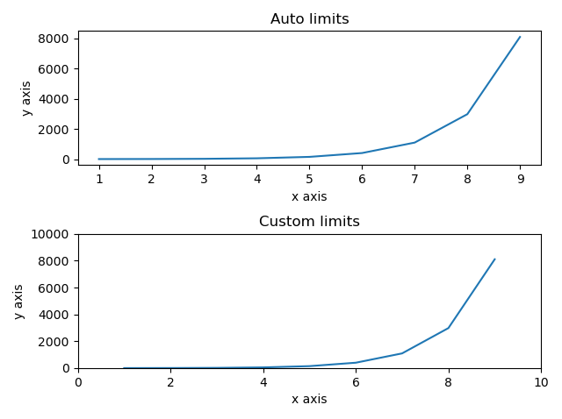
Research Computing Department
35
Formatting
Limiting axes view:
Let’s see some examples:
03_Formatting/limits.ipynb
Grids
Labels
Spines
Scale
Limits
Ticks
Twin axes
Legend

Slide 36
Research Computing Department
36
Formatting
Ticks are the markers denoting data points on axes. Matplotlib's default tick locators and formatters are designed to be generally sufficient in many common situations. Position and labels of ticks can be explicitly mentioned to suit specific requirements.
The set_xticks() and set_yticks() function takes a list object as argument. The elements in the list denote the positions on corresponding action where ticks will be displayed.
Similarly, labels corresponding to tick marks can be set by set_xlabels() and set_ylabels() functions respectively.
Grids
Labels
Spines
Scale
Limits
Ticks
Twin axes
Legend

Slide 37
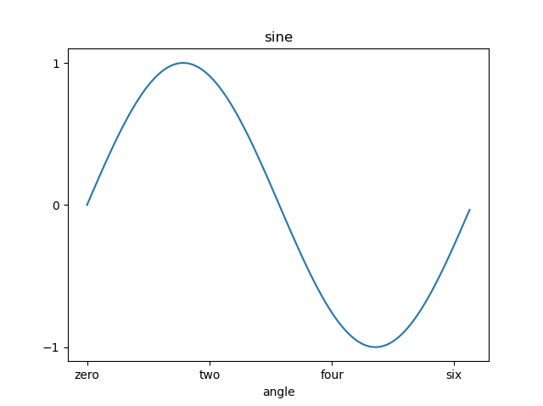
Research Computing Department
37
Formatting
Ticks and ticks’ labels:
Let’s see some examples:
03_Formatting/ticks.ipynb
Grids
Labels
Spines
Scale
Limits
Ticks
Twin axes
Legend

Slide 38
Research Computing Department
38
Formatting
It is useful to have dual x or y axes in a figure. More so, when plotting curves with different units together. Matplotlib supports this with the twinx and twiny functions.
Axes.twinx(): Create a twin Axes sharing the x-axis.
Axes.twiny(): Create a twin Axes sharing the y-axis.
Grids
Labels
Spines
Scale
Limits
Ticks
Twin axes
Legend

Slide 39
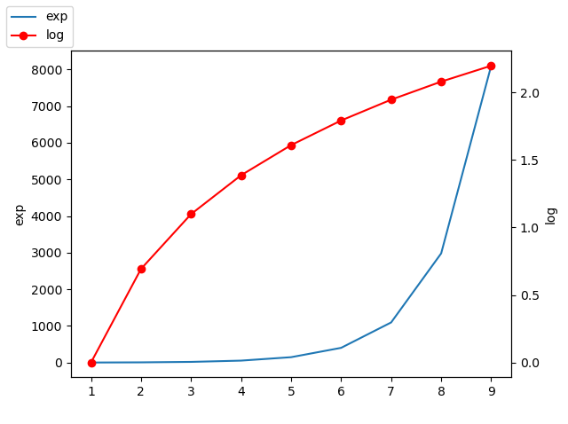
Research Computing Department
39
Formatting
Twin axes:
Let’s see some examples:
03_Formatting/twin_axes.ipynb
Grids
Labels
Spines
Scale
Limits
Ticks
Twin axes
Legend

Slide 40
Research Computing Department
40
Formatting
The legend(handles, labels, loc) method of axes class adds a legend to the plot figure. It takes three parameters:
handles: a sequence of Line2D or Patch instances.
labels: a sequence of strings.
loc: can be a string or an integer specifying the legend location.
Grids
Labels
Spines
Scale
Limits
Ticks
Twin axes
Legend
Location String | Location Code
'best' | 0
'upper right' | 1
'upper left' | 2
'lower left' | 3
'lower right' | 4
'right' | 5
'center left' | 6
'center right' | 7
'lower center' | 8
'upper center' | 9
'center' | 10

Slide 41
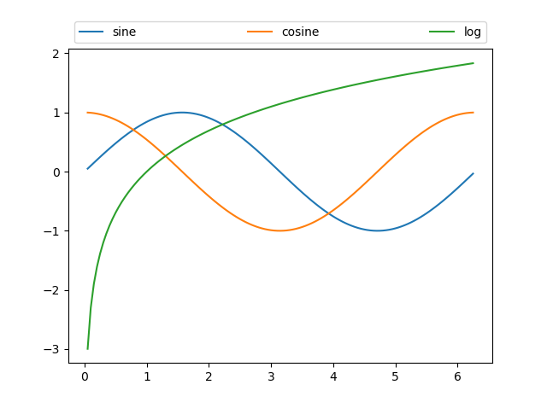
Research Computing Department
41
Formatting
Legend:
Grids
Labels
Spines
Scale
Limits
Ticks
Twin axes
Legend

Slide 42
Research Computing Department
42
Formatting
In order to have more control on the legend’s position and size, bbox_to_anchor parameter can be used together with loc. Following is the syntax:
bbox_to_anchor=(x, y): Places the corner of the legend specified by loc at x, y.
bbox_to_anchor=(x, y, width, height). Specifies the box where the legend is placed in.
Grids
Labels
Spines
Scale
Limits
Ticks
Twin axes
Legend

Slide 43
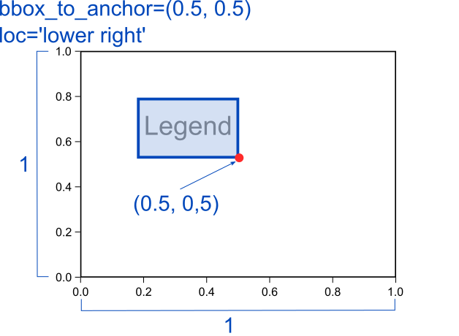
Research Computing Department
43
Formatting
Legend position bbox_to_anchor=(x, y)
Grids
Labels
Spines
Scale
Limits
Ticks
Twin axes
Legend

Slide 44
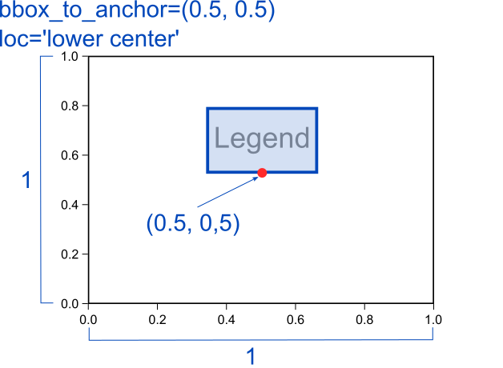
Research Computing Department
44
Formatting
Legend position bbox_to_anchor=(x, y)
Grids
Labels
Spines
Scale
Limits
Ticks
Twin axes
Legend

Slide 45
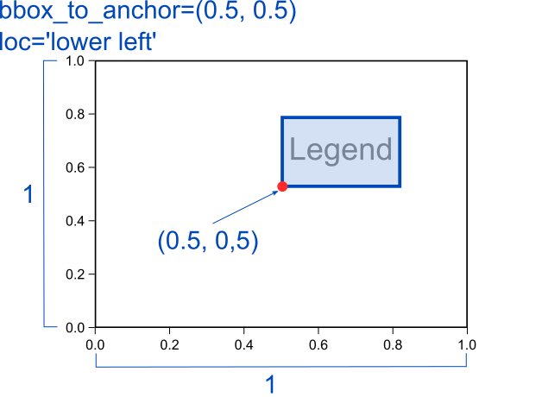
Research Computing Department
45
Formatting
Legend position bbox_to_anchor=(x, y)
Grids
Labels
Spines
Scale
Limits
Ticks
Twin axes
Legend

Slide 46
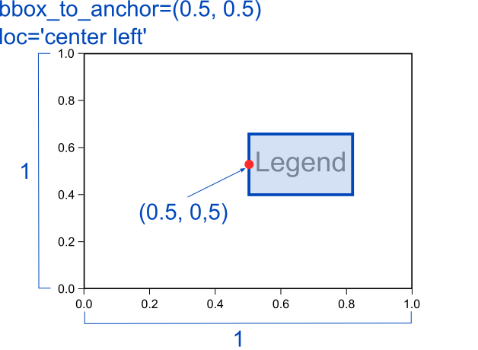
Research Computing Department
46
Formatting
Legend position bbox_to_anchor=(x, y)
Grids
Labels
Spines
Scale
Limits
Ticks
Twin axes
Legend

Slide 47
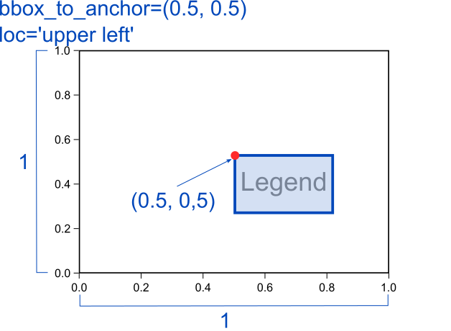
Research Computing Department
47
Formatting
Legend position bbox_to_anchor=(x, y)
Grids
Labels
Spines
Scale
Limits
Ticks
Twin axes
Legend

Slide 48
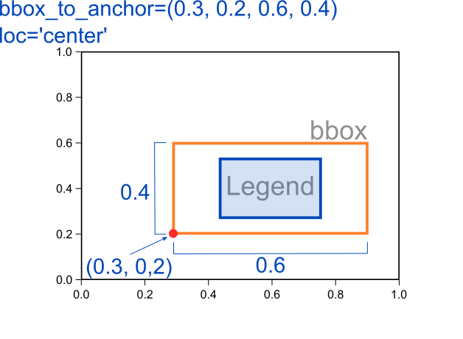
Research Computing Department
48
Formatting
Legend position bbox_to_anchor=(x, y, width, height)
Grids
Labels
Spines
Scale
Limits
Ticks
Twin axes
Legend

Slide 49
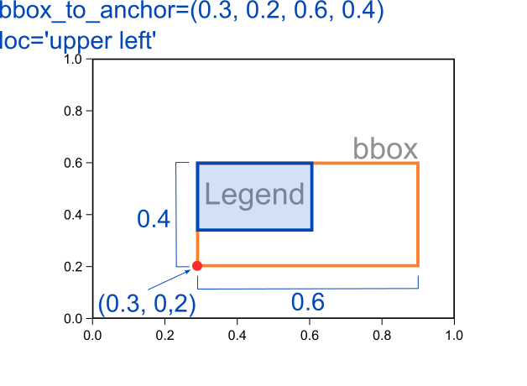
Research Computing Department
49
Formatting
Legend position bbox_to_anchor=(x, y, width, height)
Grids
Labels
Spines
Scale
Limits
Ticks
Twin axes
Legend

Slide 50
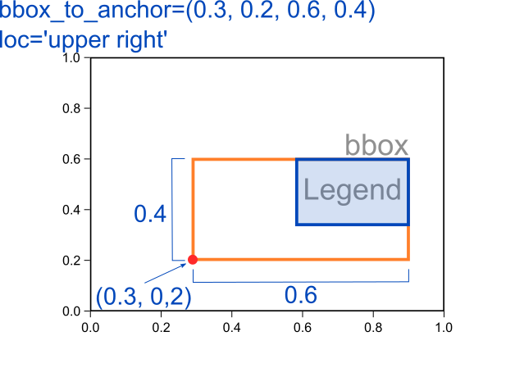
Research Computing Department
50
Formatting
Legend position bbox_to_anchor=(x, y, width, height)
Grids
Labels
Spines
Scale
Limits
Ticks
Twin axes
Legend

Slide 51
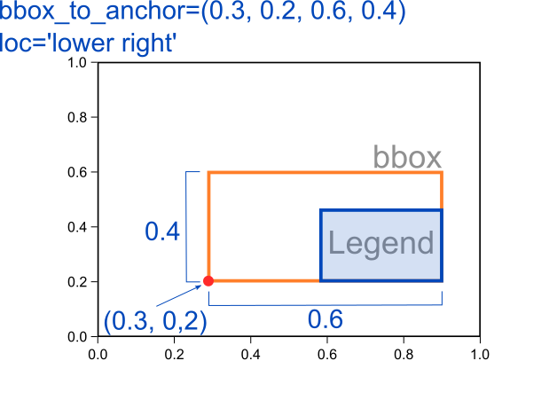
Research Computing Department
51
Formatting
Legend position bbox_to_anchor=(x, y, width, height)
Grids
Labels
Spines
Scale
Limits
Ticks
Twin axes
Legend

Slide 52
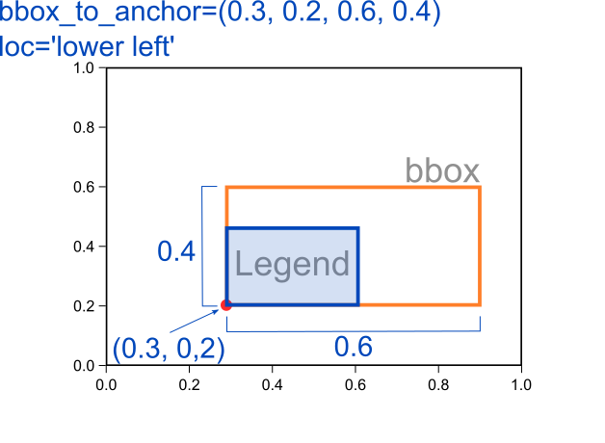
Research Computing Department
52
Formatting
Legend position bbox_to_anchor=(x, y, width, height)
Grids
Labels
Spines
Scale
Limits
Ticks
Twin axes
Legend

Slide 53
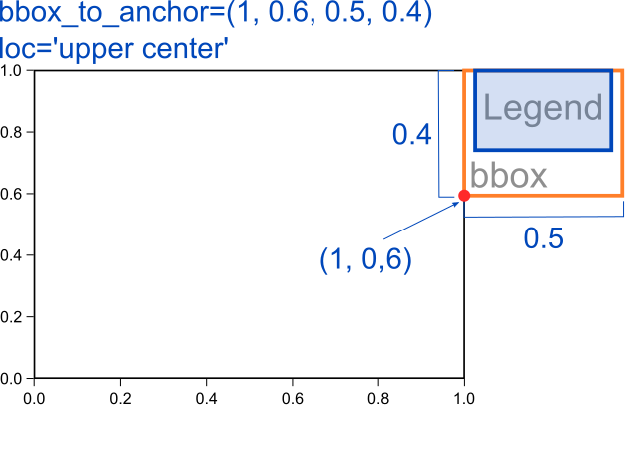
Research Computing Department
53
Formatting
Legend position bbox_to_anchor=(x, y, width, height)
Let’s see some examples:
03_Formatting/legend.ipynb
Grids
Labels
Spines
Scale
Limits
Ticks
Twin axes
Legend

Slide 54
Research Computing Department
54
2D plots
Scatter plots are used to plot data points on x and y axis in the attempt to show how much one variable is affected by another.
A third variable can be set to correspond to the color or size of the markers, thus adding yet another dimension to the plot.
Signature of Axes.scatter() function:
Axes.scatter(x,y,s,c,cmap)
Let’s see some examples:
04_2D_plots/scatter.ipynb
Scatter
Bar
Pie
Imshow
Contour

Slide 55
Research Computing Department
55
2D plots
Bar charts present categorical data with rectangular bars with heights or lengths proportional to the values that they represent. The bars can be plotted vertically or horizontally.
One axis of the chart shows the specific categories being compared, and the other axis represents a measured value.
Signature of Axes.bar() function:
Axes. bar(x, height, width, bottom, align)
Let’s see some examples:
04_2D_plots/bar.ipynb
Scatter
Bar
Pie
Imshow
Contour

Slide 56
Research Computing Department
56
2D plots
A Pie Chart can only display one series of data. Pie charts show the size of items (called wedge) in one data series, proportional to the sum of the items. The data points in a pie chart are shown as a percentage of the whole pie.
Signature of Axes.pie() function:
Axes. pie(x, labels, colors, autopct)
autopct is used to label the wedges with their numeric value. The label will be placed inside the wedge. The format string will be fmt%pct.
Let’s see some examples:
04_2D_plots/pie.ipynb
Scatter
Bar
Pie
Imshow
Contour

Slide 57
Research Computing Department
57
2D plots
Display data as an image, i.e., on a 2D regular raster.
The input may either be actual RGB(A) data, or 2D scalar data, which will be rendered as a pseudocolor image.
For displaying a grayscale image set up the color mapping using the parameters cmap='gray', vmin=0, vmax=255.
Axes. imshow(x, cmap, vmin, vmax)
Let’s see some examples:
04_2D_plots/imshow.ipynb
Scatter
Bar
Pie
Imshow
Contour

Slide 58
Research Computing Department
58
2D plots
Contour plots (sometimes called Level Plots) are a way to show a three-dimensional surface on a two-dimensional plane.
It graphs two predictor variables X Y on the y-axis and a response variable Z as contours. These contours are sometimes called the z-slices or the iso-response values.
Axes.contour(x, y, z, levels)
Axes.contourf(x, y, z, levels)
Let’s see some examples:
04_2D_plots/contour.ipynb
Scatter
Bar
Pie
Imshow
Contour

Slide 59
Research Computing Department
59
3D plots
The Axes3D.contour3D() function creates three-dimensional contour plot. It requires all the input data to be in the form of two-dimensional regular grids, with the Z-data evaluated at each point.
Axes object need to be 3D (projection=‘3d’)
Axes3D.contour3D(x, y, z, levels)
Let’s see some examples:
05_3D_plots/contour.ipynb
Contour
Wireframe
Surface

Slide 60
Research Computing Department
60
3D plots
Wireframe plot takes a grid of values and projects it onto the specified three-dimensional surface, and can make the resulting three-dimensional forms quite easy to visualize. The Axes3D.plot_wireframe() function is used for the purpose.
Axes object need to be 3D. (projection=‘3d’)
Axes3D.plot_wireframe(x, y, z, rstride, cstride)
Let’s see some examples:
05_3D_plots/wireframe.ipynb
Contour
Wireframe
Surface

Slide 61
Research Computing Department
61
3D plots
Surface plot shows a functional relationship between a designated dependent variable (Y), and two independent variables (X and Z). A surface plot is like a wireframe plot, but each face of the wireframe is a filled polygon.
This can aid perception of the topology of the surface being visualized. The plot_surface() function x,y and z as arguments.
Axes object need to be 3D. (projection=‘3d’)
Axes3D.plot_surface(x, y, z, rstride, cstride)
Let’s see some examples:
05_3D_plots/surface.ipynb
Contour
Wireframe
Surface

Slide 62
Research Computing Department
62
Save plots
The figures created can be saved to our local machines in different formats using pyplot.savefig() method.
pyplot.savefig(fname, dpi, format, facecolor, edgecolor)
Let’s see some examples:
06_Save_plots/save_plots.ipynb
Save plots

